Slide 1


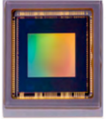




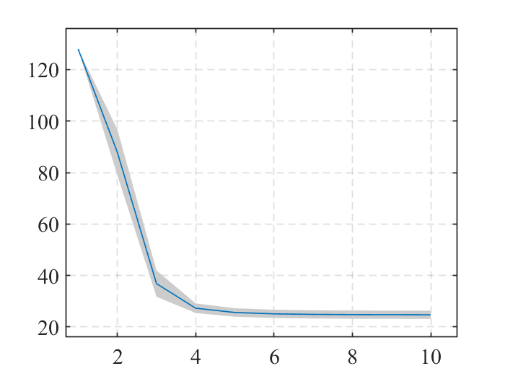




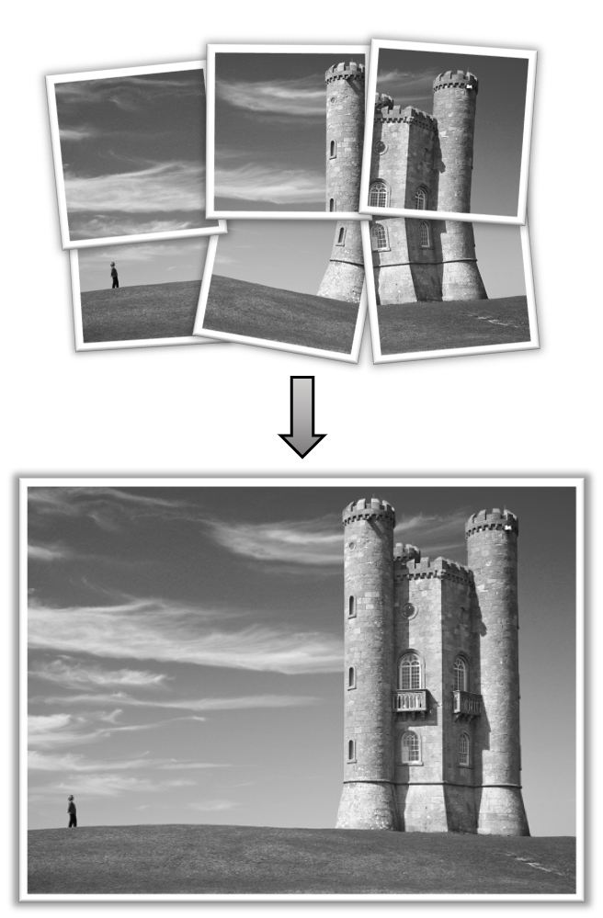
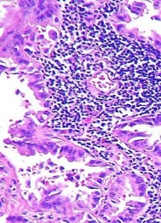
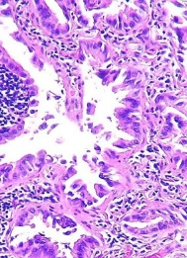
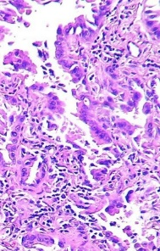

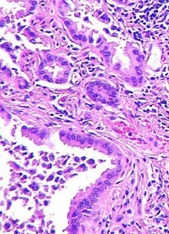
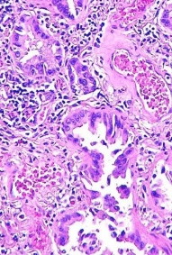
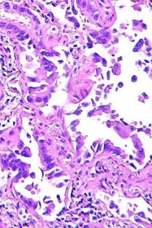
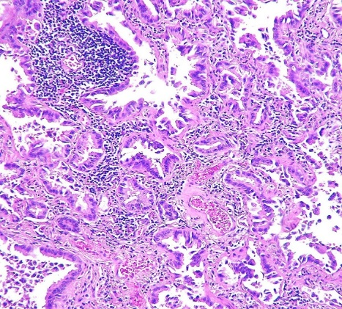
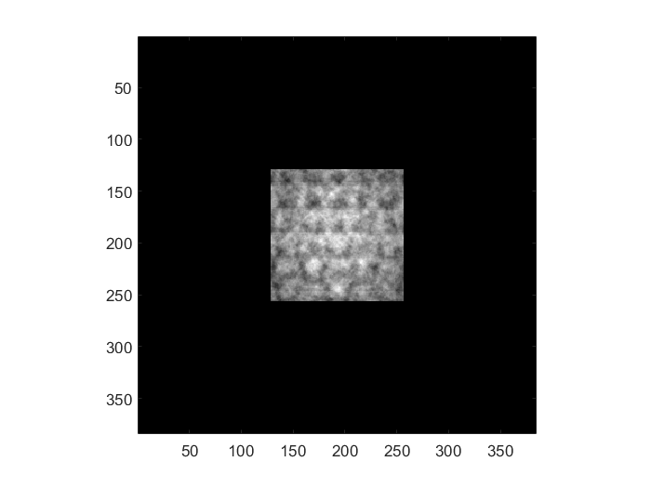
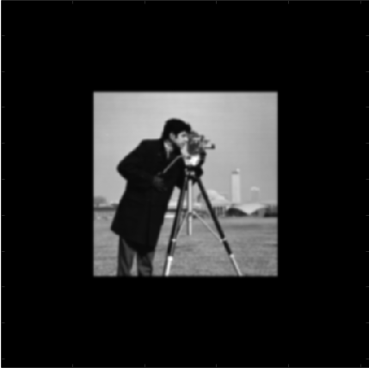
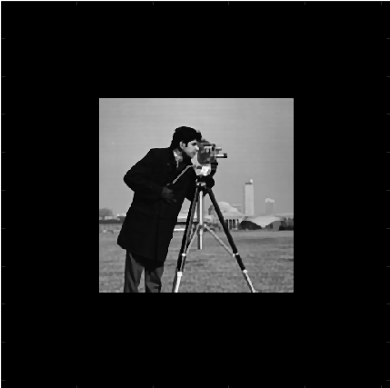
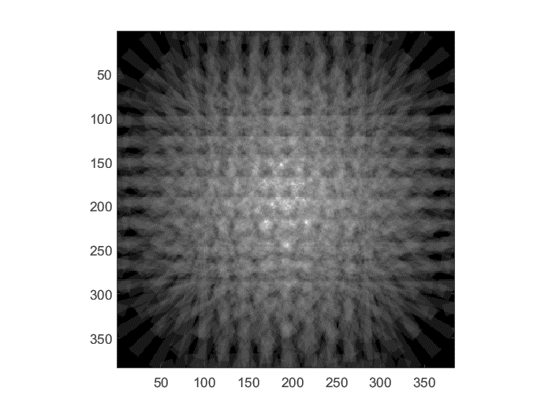
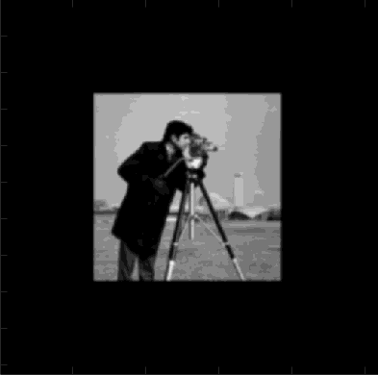

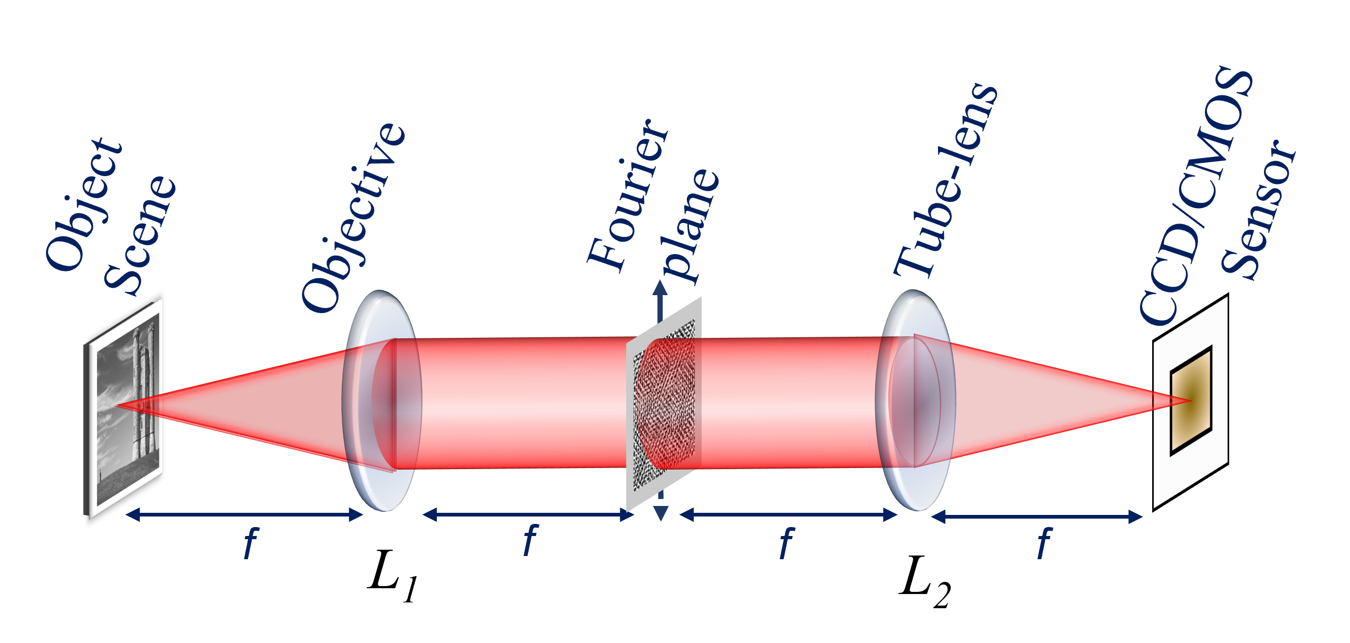
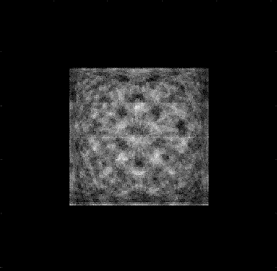
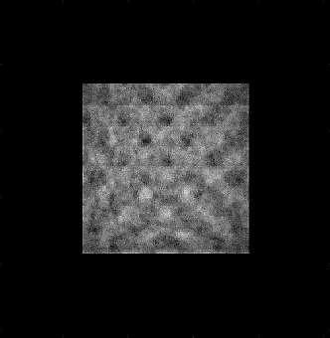
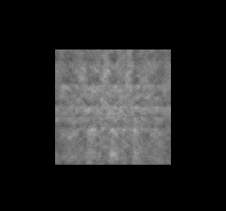

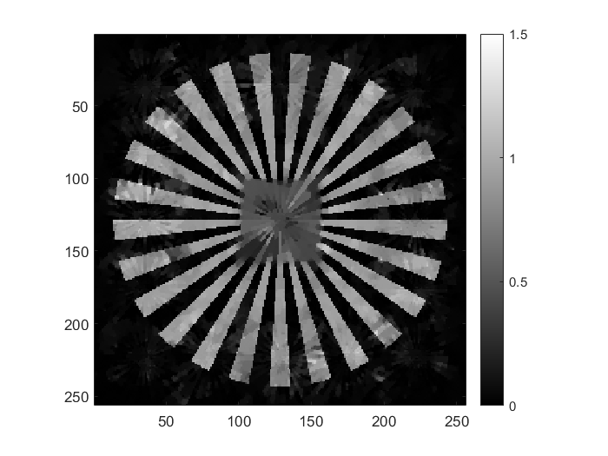
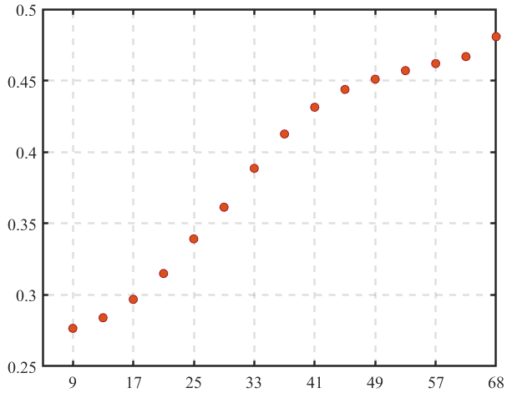
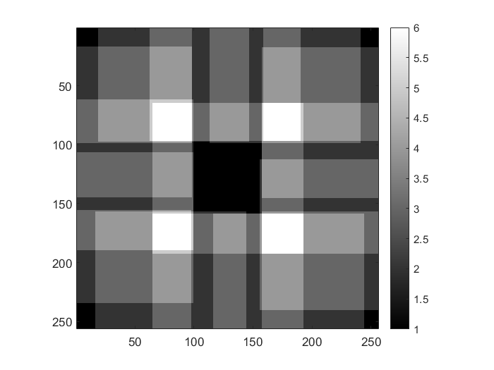
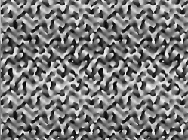

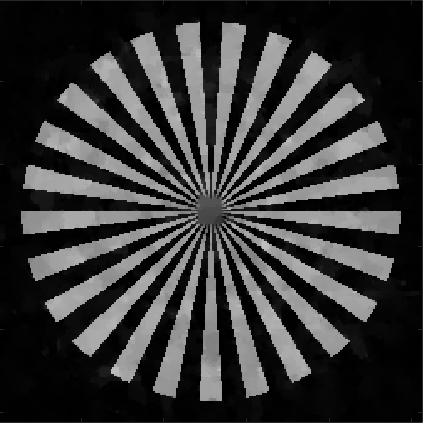
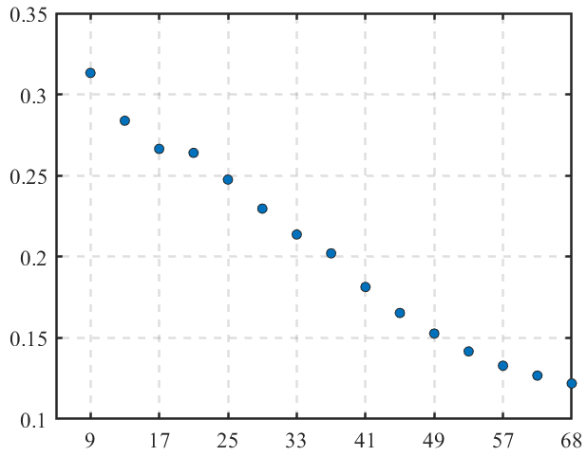
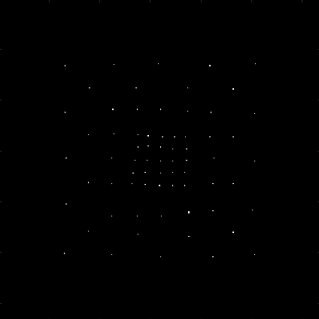
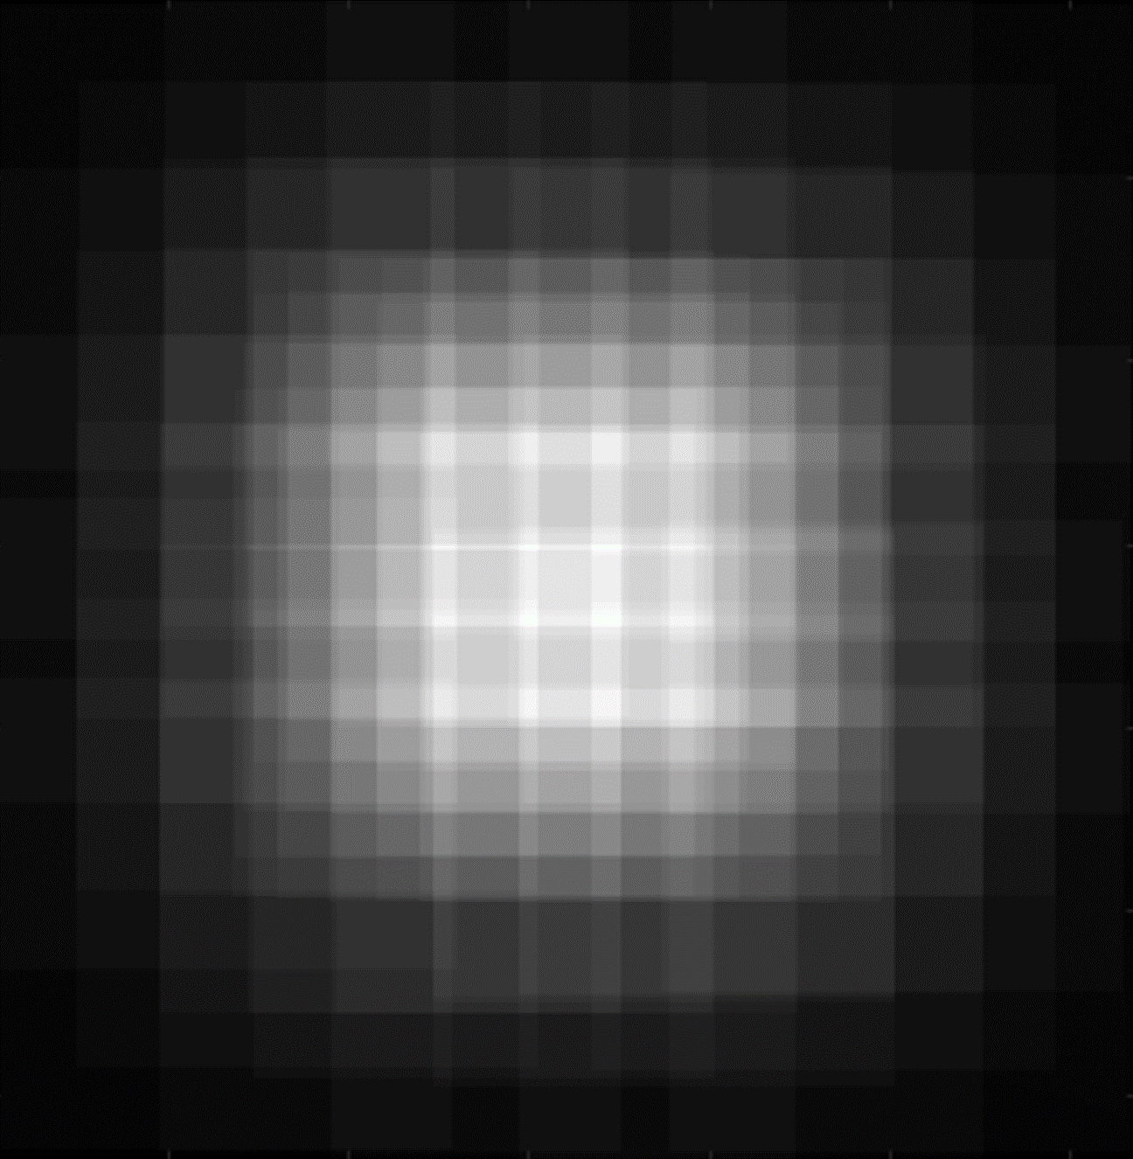
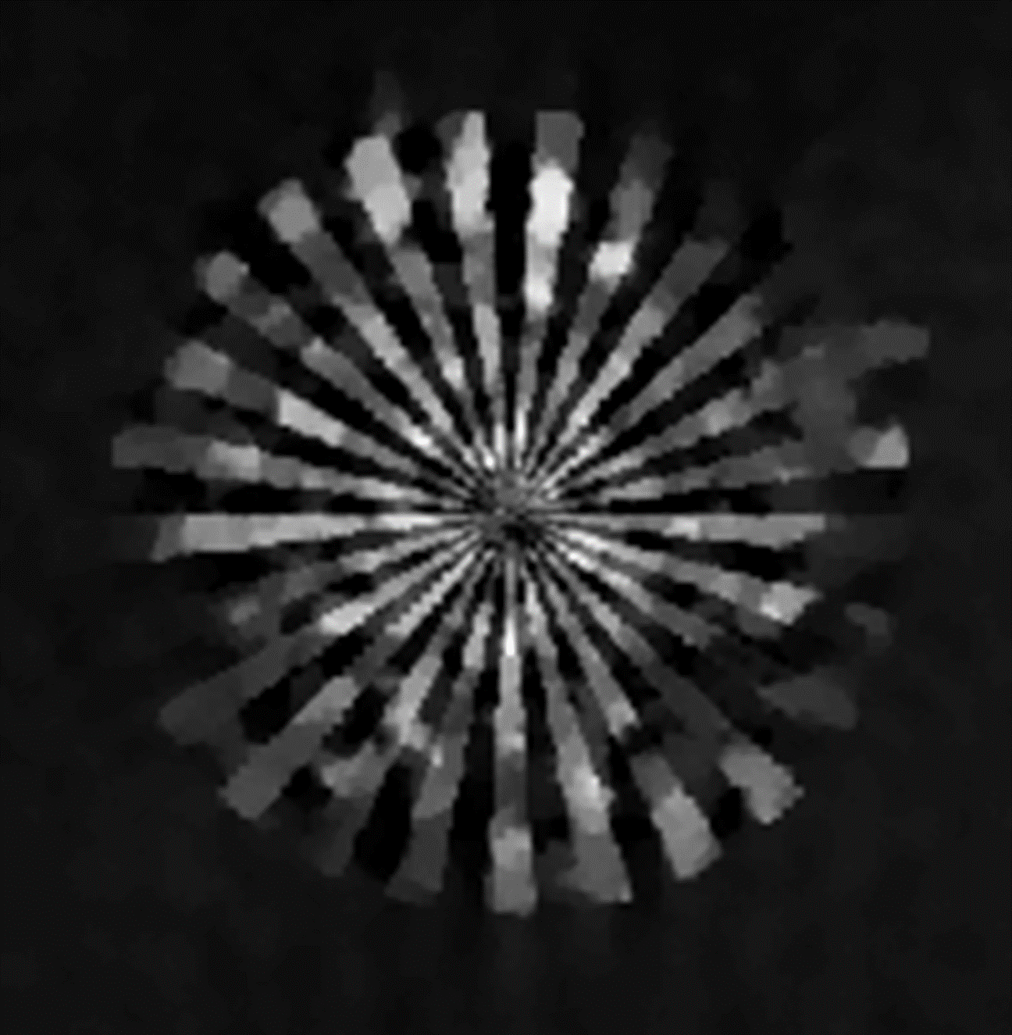
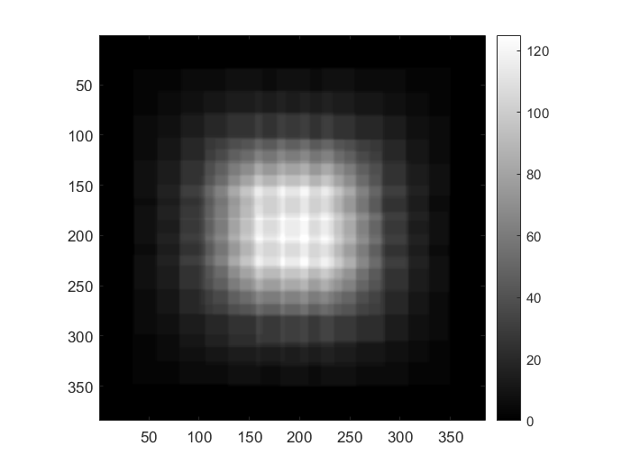
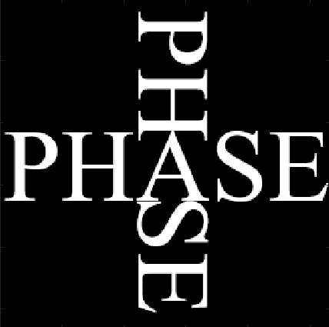
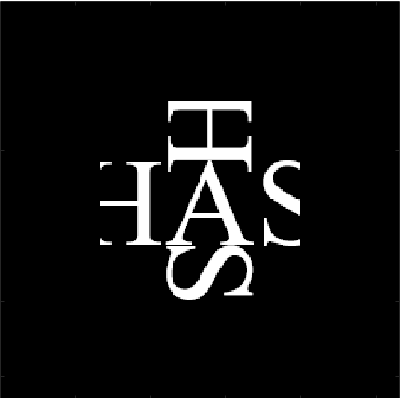
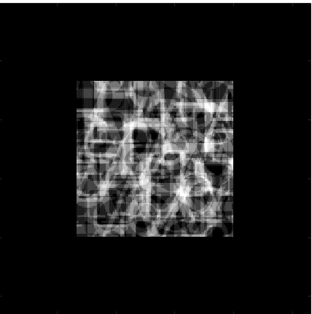

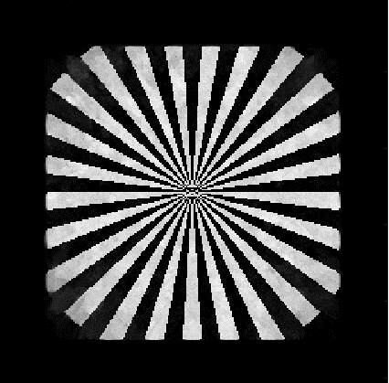


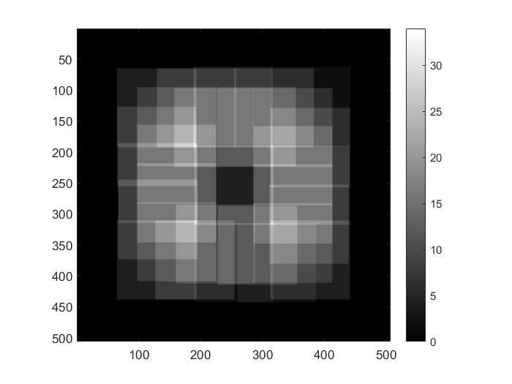
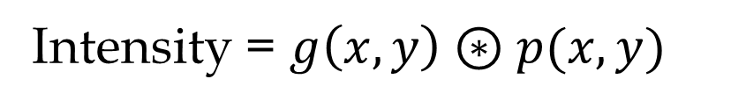



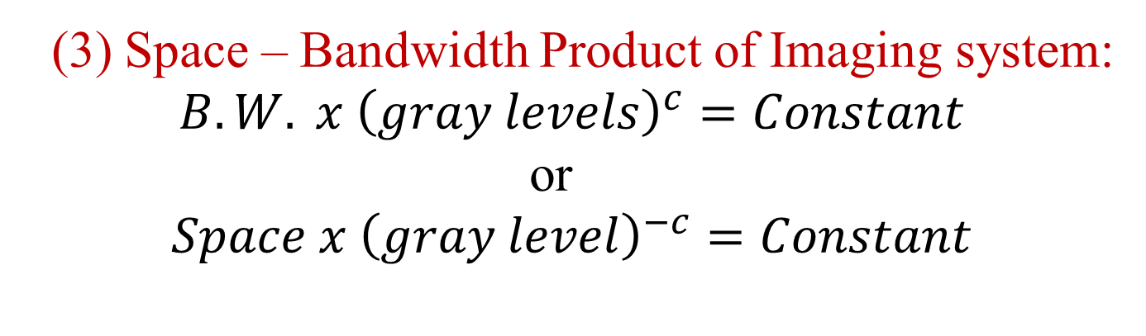
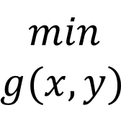


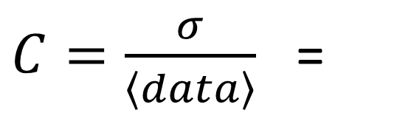



Point Spread function Engineering for Extended FOV Imaging
Ritika Malik, Prof. Kedar Khare and Prof. Ravi Krishnan Elangovan¹
Department of physics, Indian Institute of Technology Delhi
¹Department of Biochemical engineering and biotechnology, IIT Delhi
PMRF Annual Symposium 2024
1. Background :
3. Challenges :
Bit-levels Results :
Conventional Imaging :
Sensor
Digital Image
(1) Number of Impulses
Effect of bit-levels onto the bandwidth of the system
Object/Sample
Optical Coding
Computational Imaging :
(2) Distribution
Object/Sample
Optical Coding
Sensor
Digital Coding
Reconstruction
Bandwidth (B.W.)
2. Introduction :
(3) Extent of Impulses
Bit-levels
With the current model, little manipulation gives
$B.W. X {\left(gray levels\right)}^{c}=constant=b;$---(1)
Original space-bandwidth product is
$\left(space\right)X \left(B.W.\right)=invariance$
With the introduction of bit-levels
$\left(space\right)X {\left(gray levels\right)}^{−c}=invariance$ ---(2)
?
3. Challenges (Tools) :
De-convolution Application :
(1) Energy Parameter :
Blur object
Recovered object
2
(a)
10 bit
(b)
$$||$$
$$||$$
Panorama Photography Mode
Digital Pathology
$$R=\frac{{\left|\left|SAx\right|\right|}^{2}2}{{\left|\left|Ax\right|\right|}^{2}2}=$$
2
1
2
Problem : Can we increase the detected FOV in Single shot image capture ?
Solution : Phase Mask at the Fourier plane of an imaging system.
$$||$$
$$||$$
(2) Contrast :
2
(c)
4 bit
(d)
Imaging System :
$C=\frac{σ}{\left\langle data\right\rangle }$ =
Number of Impulses/area
3. Simulation Results :
Conclusion :
MPIR
Overlapped Area
Extended FOV
Energy parameter as a function of Impulse’s Number
(1) Necessary Condition :
(a1)
MPIR = 17
(b1)
(c1)
Number of impulses has to be such that it bring object information with-in the detection region.
Design of an extended FOV system with MPIR therefore involves a trade-off between increased energy ratio R and reduction in contrast C.
For a given detector size, the extent of PSF has to be such that there is a enough overlapping area (Algorithmic Condition).
(c1)
(d1)
6
Information
Regime
Phase Mask Displayed on SLM
Multiple Point Impulse Response (MPIR) as PSF
Energy parameter (R)
$$2π$$
0
1.5
(c2)
(a2)
MPIR = 29
(b2)
1
(c2)
Number of Impulses
F
(d)
Contrast parameter as a function of Impulse’s Number
(2) Sufficient Condition :
0
(a3)
MPIR = 68
1
11
0
1.5
(d2)
Contrast Regime
The number of measurements must be at least of the order of 3K log(N/K ) for a K -sparse object, for enabling an extended FOV system.
Extended FOV Principle :
MPIR = 68
(b3)
(c3)
Contrast parameter (C)
Single Point
PSF
(a)
Multiple Point
PSF
30
(3) Space – Bandwidth Product of Imaging system:
$$B.W. x {\left(gray levels\right)}^{c}=Constant$$
or
$$Space x {\left(gray level\right)}^{−c}=Constant$$
(d)
0
1.5
Number of Impulses
$$Overlapped area= sensor⊛psf(−r)$$
Simulation Results :
References :
MPIR
0
Energy parameter as a function of Extent of Impulses
(b)
(c)
(e)
(f)
Overlapped Area
Extended FOV
(1). Malik, R., and Khare, K., , "Single-shot extended field of view imaging using point spread function engineering," J. Opt. Soc. Am. A 40, 1066-1075 (2023)
(a1)
64x64
(b1)
(c1)
(d1)
Information Regime
Original Object
Limited size
detector
Scrambled image
Recovered image
Energy parameter (R)
(2). Malik, R., Elangovan, R., and Khare, K., "Computational imaging with an extended field of view", Journal of Optics, 23, 2021, pp. 085703.
Algorithmic Recovery
128 x 128
0
7
0
1.5
Object Recovery as the Optimization Problem :
(a2)
(b2)
(c2)
Extent of Impulses
Forward Model :
Intensity = $g\left(x,y\right)⊛p(x,y)$
Contrast parameter as a function of Extent of Impulses
(3). B. J. Stossel and N. George, “Multiple-point impulse responses controlled blurring and recovery,” Opt. Commun. 121, 156–165 (1995).
Optimization Problem :
0
25
0
1.5
Contrast Regime
$$min$$
$$g(x,y)$$
$$C=|\left|Intensity −g\left(x,y\right) ⊛p\left(x,y\right)\right||22$$
$+ α ψ(g\left(x,y\right))$
(a3)
256 x 256
(b3)
(c3)
(d2)
Contrast parameter (C)
(4). R. G. Baraniuk, “Compressive sensing lecture notes,” IEEE Signal Process. Mag. 24(4), 118–121 (2007).
Measurement
(Scramble data)
Forward Model
Penalty
(Sparsity)
5
30
0
1.5
Extent of Impulses

