Slide 1

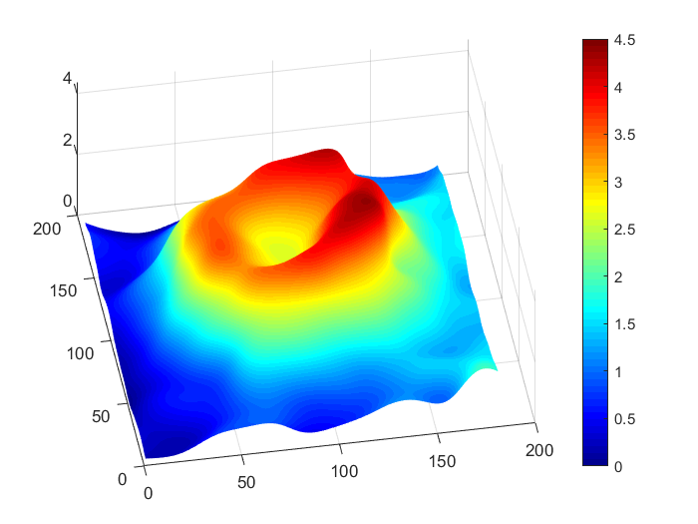
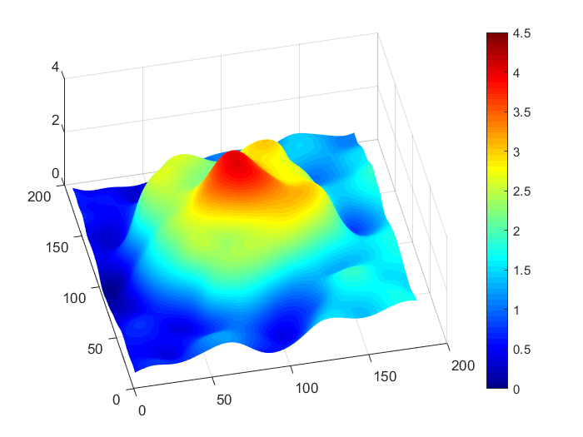
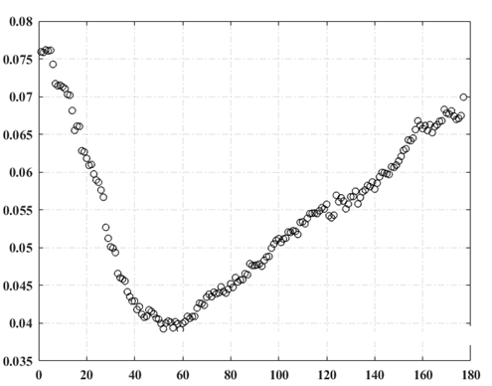
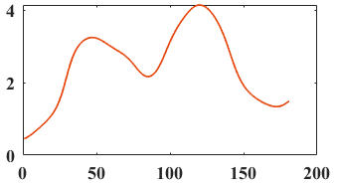
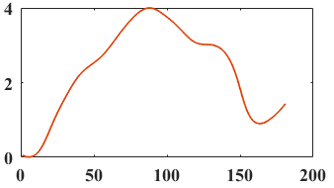
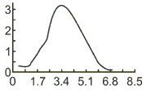
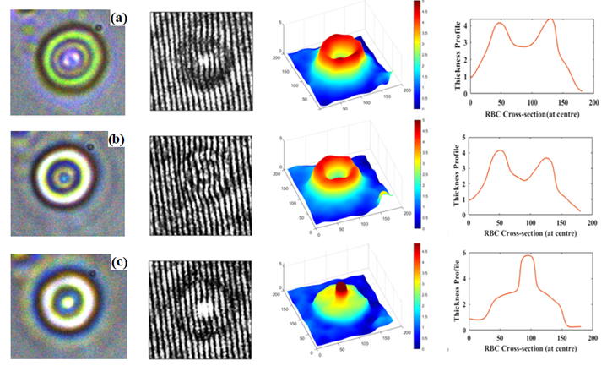
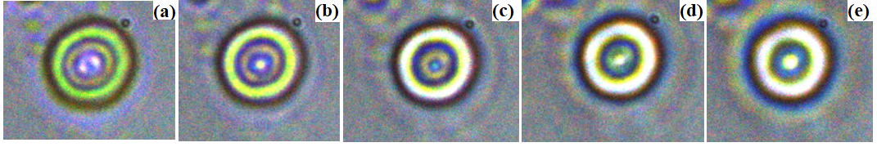
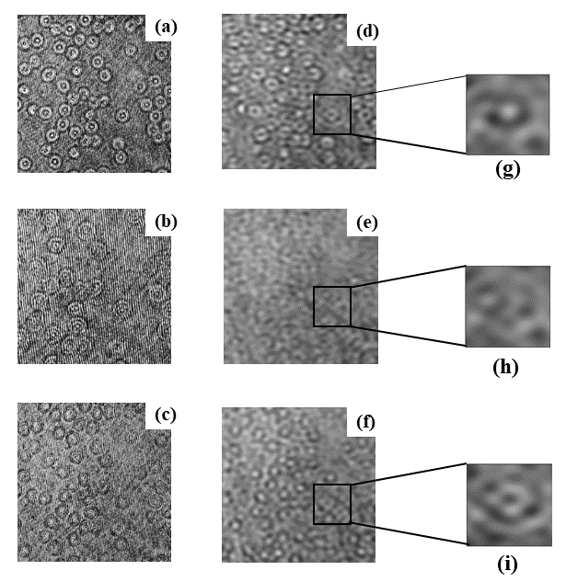
A Practical Criterion for Focusing of Unstained Cell Samples
Using a Digital Holographic Microscope
Ritika Malik, Purnima Sharma, Sruthy Poulose¹, Sarita Ahlawat and Kedar Khare
Department of physics, Indian Institute of Technology Delhi
¹School of Physics, Trinity College, Dublin 2, Ireland
ABSTRACT: We proposed a practical criterion for the focusing of unstained cell samples using digital holographic microscopy. This method allows users to directly record in-focus image plane hologram and focused bright-field image of the sample simultaneously.
DEFOCUSING OF CELL SAMPLE
RESULT
Fluctuation in Intensity of filtered image
(A)
(C)
Defocus
(B)
Thickness Profile
Thickness Profile
Thickness Profile
Different Focusing plane ( distance covered = 1.5 µm /plane)
Figure: Standard deviation as function of the focus distance
RBC cross-section (at centre)
RBC cross-section (at centre)
RBC cross-section (at centre)
Brightfield
Hologram
Phase-Profile
Cross-section Profile
Healthy RBC at different focal plane
Focused unhealthy RBC
(A)
(d)
(g)
(j)
Numerical auto-focusing methods uses propagation of hologram.
Loss of brightfield information at best focus plane.
No confirmation of diseases by clinical practitioners.
(B)
(e)
(h)
(k)
(C)
(f)
(i)
(l)
Figure: (a),(b),(c) Brightfield of RBC within selected ROI at different depths from the best focus plane, (d),(e),(f) Hologram image at the respective planes (g), (h),(i) shows the phase map and (j),(k),(l) shows the phase profile through the center of the phase map.
Which one is the brightfield
image at best focus plane?
OBSERVATIONS
CONCLUSION
Small de-focus can actually distort the phase map associated with a cell and therefore can lead to false positive of healthy cell.
It’s a practical method for determination of the best focus plane associated with transparent objects that directly operates in the hologram domain.
Focused Brightfield images can also be capture simultaneously by switching illumination.
This method is important for standardization of DHM based imaging for diagnostic applications or basic cell biology research.
Figure: Holograms of blood slide at different focal depth (a) & (c) are defocus above and below the best focus plane (b); (d)-(f) crossponding low pass filtered images; (g)-(f) zoomed in ROI around RBC.
REFERENCES:
[1] Anand A, Chhaniwal VK, Patel NR, Javidi B. Automatic Identification of Malaria-Infected RBCWith Digital Holographic Microscopy Using Correlation Algorithms. IEEE Photonics Journal 2012; 4(5): 1456-1464.
[2]. Dubois F, Schockaert C, Callens N, Yourassowsky C. Focus plane detection criteria in digital holography microscopy by amplitude analysis. Opt. Express 2006; 14: 5895–5908.
[3]. Rinehart MT, Park HS, Wax A. Influence of defocus on quantitative analysis of microscopic objects and individual cells with digital holography. Biomed Opt Express 2015; 6: 2067-2075.
[4]. Kedar K, P.T. AS, Joby J. Single shot high resolution digital holography. Opt. Express 2013; 21: 2581–2591.

